Slide 1


Trends in Domestic Aviation From 1990-2009
By ECE180 Group 3
Alexander Potapov / Cheng-Yun Wu / Chenhua Shi / Zhennong Chen / You-Huei Ju / Hua Shao

Slide 2
Our Database:
US Domestic Flights 1990 to 2009

Slide 3
Database
Overview
Available Features:
Origin | Airport Code/City
Destination | Airport Code/City
Passenger | Flown on Route
Seats | Total Seats Available
Flights | # of Flights in the Month
Distance | Distance in Miles
Fly Date | Month/Year of Flights
Origin population | Population of Source
Destination population | Population of Target
Sources:
Infochimps,
US Census Bureau,
Bureau of Transportation Statistics

Slide 4
Benefits and
Challenges
Benefits:
3.5 Million Flight Records/Deep Database
Easy to Read with pandas
Very Specific Numbers Available
Challenges:
Lack of Day-to-Day Resolution
Lack of Airport Location Data
Large Number of Cities Complicates Training
Confusing Overbooking Descriptions
Ends in 2009

Slide 5

Topics Addressed
The effect of Natural Disasters on Flight Trends
The effect of Terrorist Attacks on Flight Trends
The Trends in Popular Holiday Destinations
Predicting flight occupancy based on month, origin, and destination
Source: https://www.imore.com/five-best-flight-tracking-apps-iphone

Slide 6
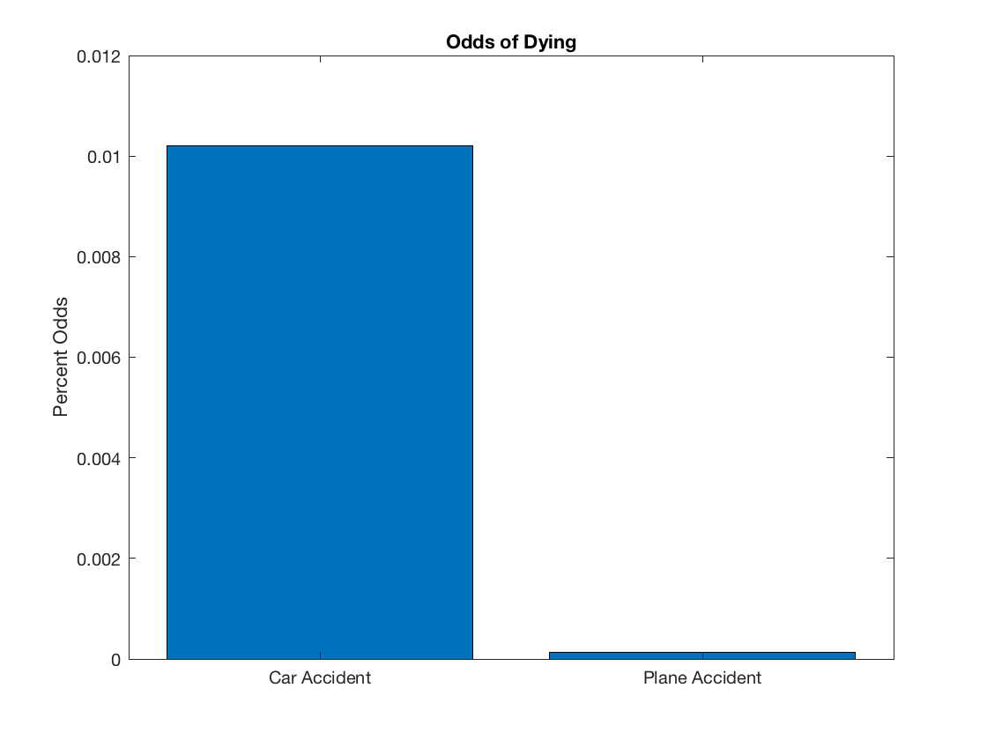
Natural Disasters,
Terrorism, and
Domestic Flights:
Correlated?
Do Terrorist events scare people away from flying?
Flying is much safer than driving by the mile and over the course of a lifetime, to the tune of having a 1/98 chance of dying in a car accident versus a 1/7,178 chance of dying in a plane accident. This is 73x difference in odds![1] We want to investigate if less people fly after terrorist events, effectively increasing their rate of death, giving more power to the attacks.
Do Natural Disasters affect Flight trends?
After major Natural disasters like Hurricanes and Earthquakes, people may want to flee their homes. We have chosen to investigate if they choose to fly away or attempt some other form of travel.
Notes:
Natural disasters and terrorism are apparently two kinds of big events affecting the domestic trends.

Slide 7
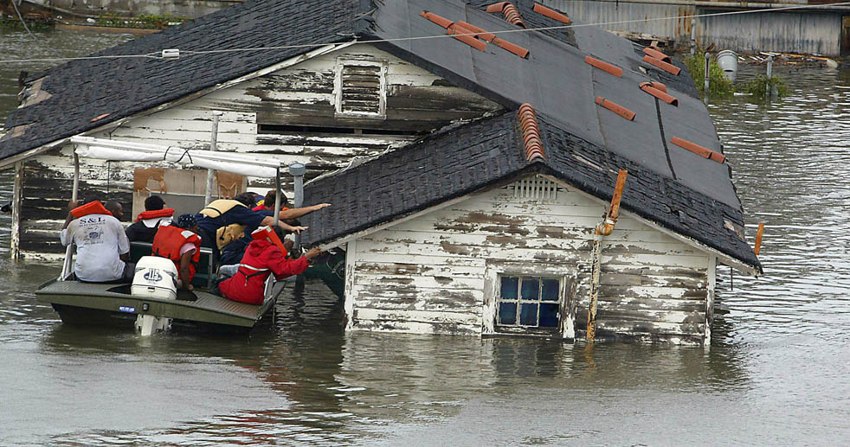
Natural Disasters
Natural Disasters destroy infrastructure, businesses, and homes.
They have caused an average of 137.5 Billion Dollars in damages per year between 2006 and 2015.[2]
We Will Investigate:
Northridge Earthquake (1994)
Hurricane Katrina (2005),
Hurricane Ike (2008),
Via: Science Magazine
Notes:
Natural disasters could destroy infrastructure, businesses, and homes.
We investigated three major natural disasters, selected by top economic loss.

Slide 8
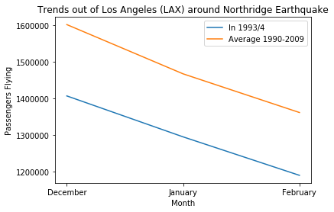
Northridge Earthquake: California, 1994
Quick Stats:
Date: January 17, 1994
Time: 4:30.55 AM PST
Magnitude: 6.7 Moment Mag. Scale
Damage: 13-44 Billion USD (1994)
Area Affected: LA County
Notes:
The first one is the northridge earthquake in LA County in January 1994. We compared the number of passengers flying out of los angeles during the affected month and the adjacent ones in 1994 and the average number obtained from 20 years at the same months. From the figure we can see actually there is no large influence by the earthquake, because they are just two straightlines with the same slope. The smaller number in 1994 is from my guess, just because there were not so many airlines at that time.

Slide 9
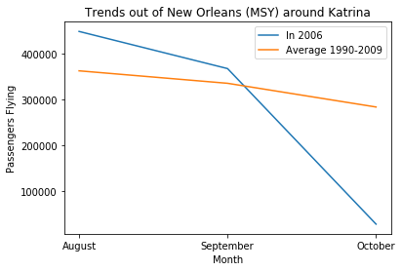
Hurricane Katrina: Louisiana, 2005
Quick Stats:
Date: August 23-31, 2005
Size: Category 5 Major Hurricane
Wind Speed: 175 MPH
Damage: 125 Billion USD (2005)
Area Affected: Eastern N. America
Notes:
The second one is the hurricane Katrina happened in Louisiana in August 2005. We did the same comparison study. From the figure we can see people were trapped in New Orleans after the hurricane because there is a huge drop of the number of passenger flying out of the city from 4 hundred thousand to less than 1 hundred thousand.

Slide 10
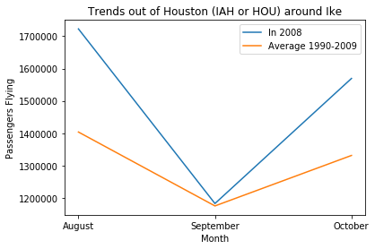
Hurricane Ike: Texas, 2008
Quick Stats:
Date: September 1-15, 2008
Size: Category 4 Major Hurricane
Wind Speed: 145 MPH
Damage: 38 Billion USD (2008)
Area Affected: South-Eastern USA
Notes:
The third one is the hurricane Ike happendd in Texas in September 2008. Here we can see when hurricane came in September, people were not able to leave their home at once, but as soon as they got the chance in October, the number of passengers flying out of Houston increased a lot. That’s why you could see a big “V” shape in the figure.

Slide 11
Natural Disasters:
Conclusions
When Airports Exist, People flee
IE: Hurricane Ike
When they don’t, they don’t
IE: Hurricane Katrina
Hurricanes have more effect than earthquakes, as they have longer ranging consequences
Notes:
So the conclusion we make here that if the natural disasters cause huge damage to the local home and public facilities, people would be trapped at first but have to leave their home for new shelters afterwards. However, if the disasters are severe enough to destroy the airports, such as hurricane katrina, people have to keep waiting at the same place for rescue. Also, Hurricanes have more effect than earthquakes as they have longer ranging consequences.

Slide 12
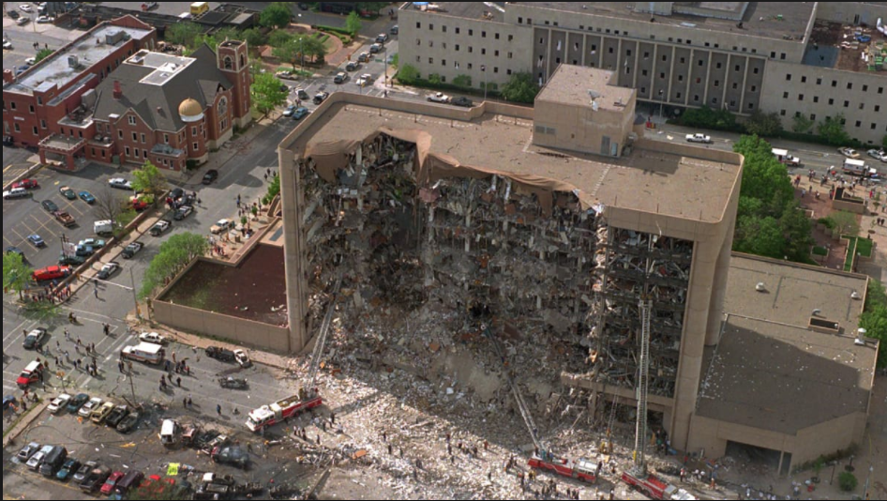
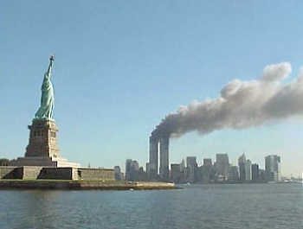
Terrorist Attacks
There were around 50 terrorist events that occured in the United State between 1990 and 2009.
We as human beings let the frequent attacks affect the decisions that we make. We tend to become more cautious about traveling by airplane and instead either in the attacked cities or drive around.
Via wikimedia commons
Via www.history.com
Selection Criteria: Number of Deaths and Injuries
Attacks selected:
World Trade Center Bombing(1993)
Oklahoma City Bombing(1995)
9/11 attacks (2001)

Slide 13
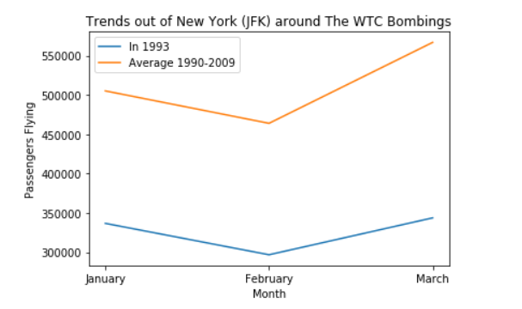
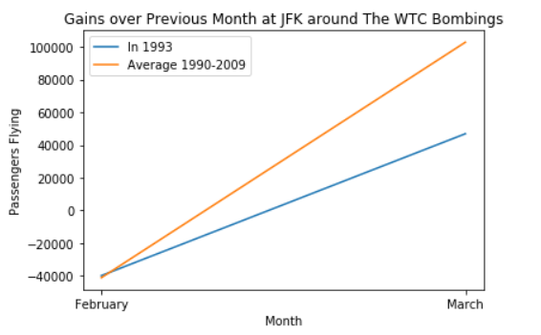
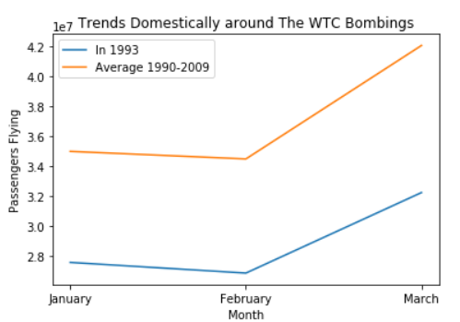
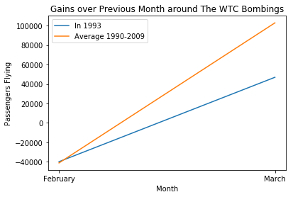
World Trade Center Bombing
Trends out of New York
Quick Stats:
Date: February 26,1993
Category: Truck Bombing
Damage: 6 deaths, 1042 injuries
Area Affected: New York
Perpetrator: Osama bin Laden's al-Qaeda organization
Trends domestically

Slide 14
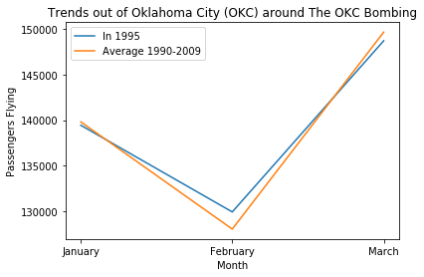
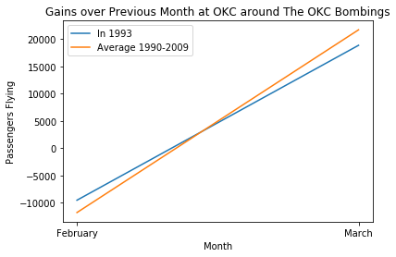
Oklahoma City Bombing
Quick Stats:
Date: April 19, 1995
Category: Truck Bombing, Domestic Terrorism
Damage: 168 deaths, 680+ injuries
Area Affected: Oklahoma City
Perpetrator: Timothy McVeigh

Slide 15
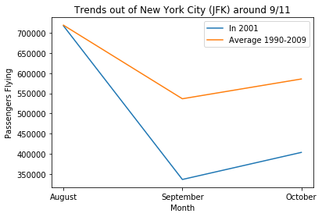
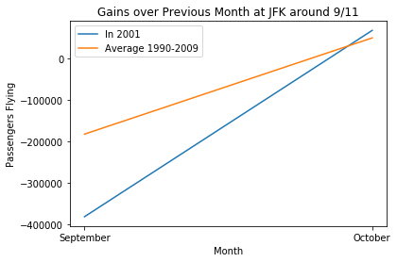
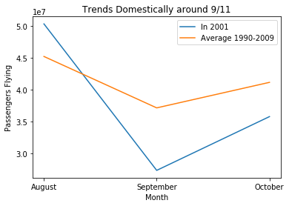
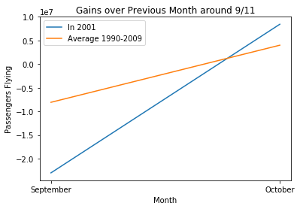
9/11 attacks
Trends out of New York
Quick Stats:
Date: September 11, 2001
Category: Aircraft Hijacking, Suicide Attacks
Damage: 2996 deaths, 6000+ injuries
Area Affected: New York
Perpetrator: Osama bin Laden's al-Qaeda organization
Trends domestically

Slide 16
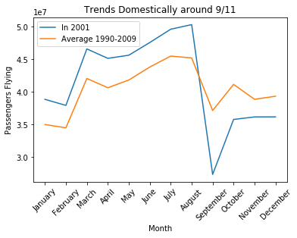
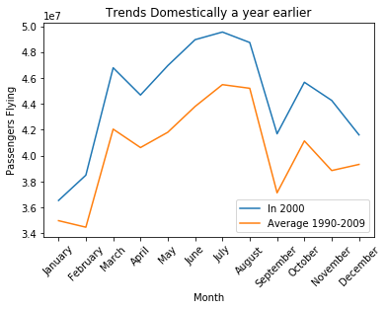
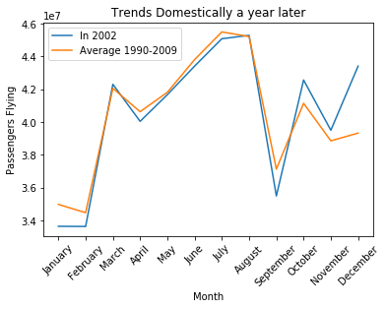
9/11 attacks
Trends domestically around years
Quick Stats:
Date: September 11, 2001
Category: Aircraft Hijacking, Suicide Attacks
Damage: 2996 deaths, 6000+ injuries
Area Affected: New York
Perpetrator: Osama bin Laden's al-Qaeda organization

Slide 17
Terrorism:
Conclusions
When the attacks are International
People fly less
When the attacks involve planes
People fly less
Cumulative!
When the attacks are domestic
There is no effect on flying

Slide 18
The Trends in Popular Destinations

Slide 19
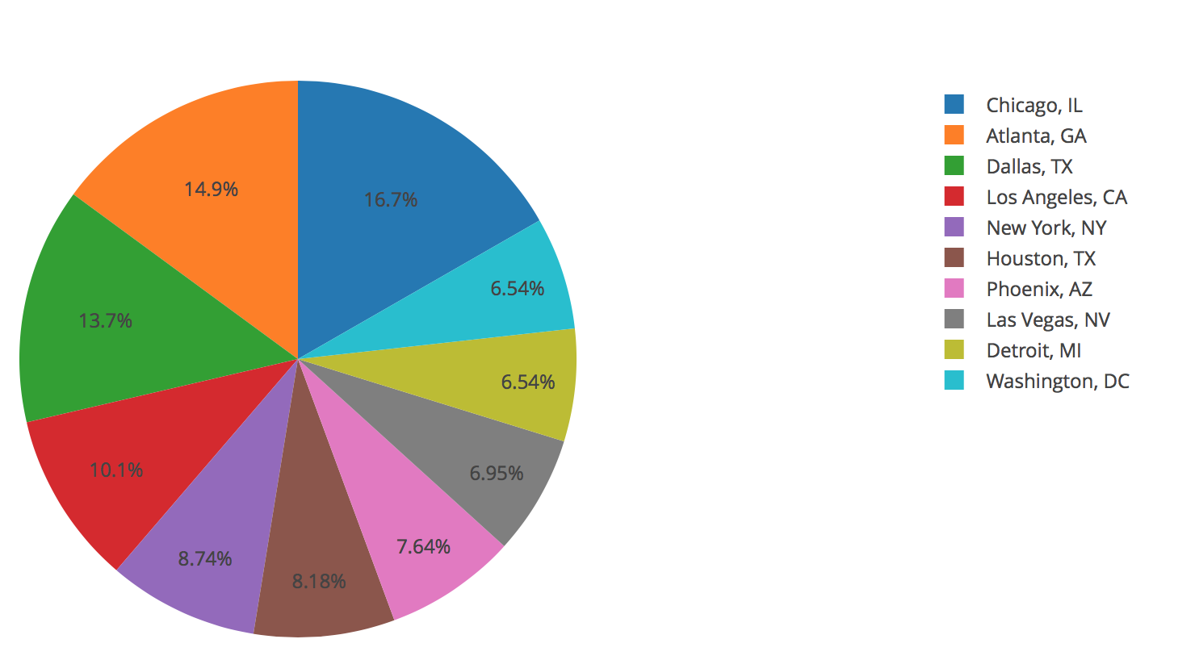
Top 10 Destinations with most Passengers

Slide 20
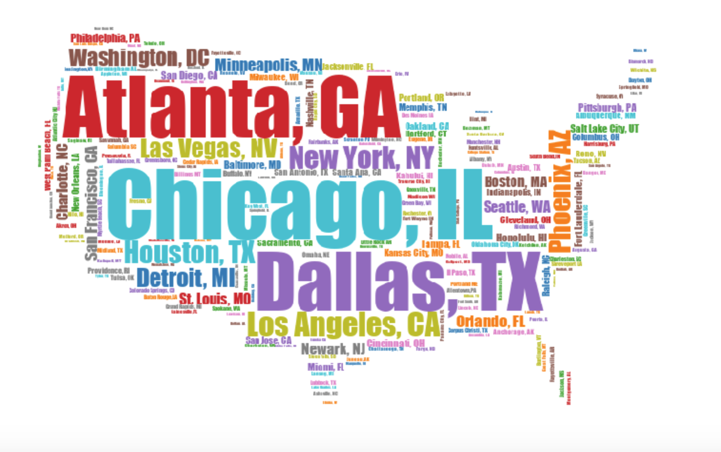

Slide 21
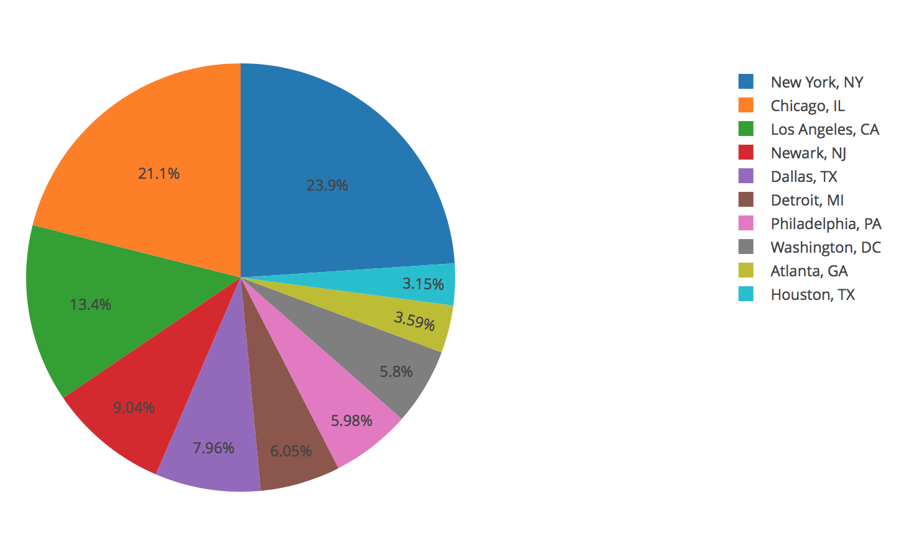
Top 10 Origins with most Population

Slide 22


Slide 23
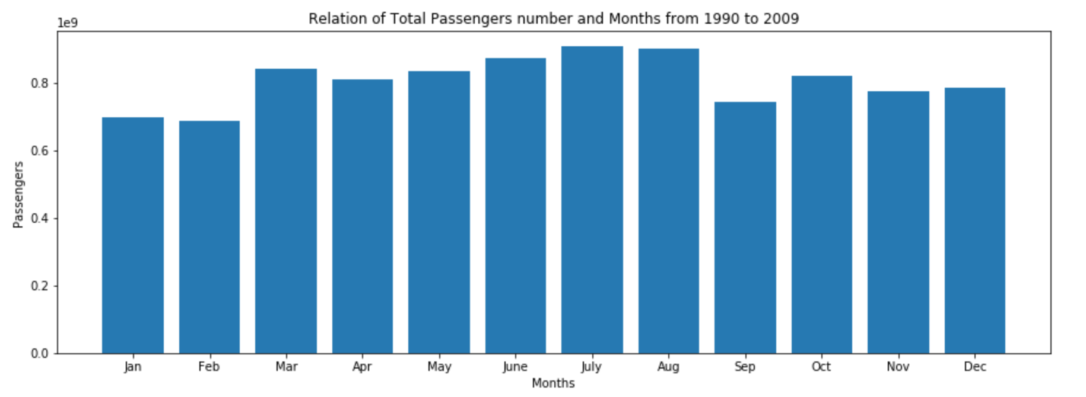
Relation of Total Passengers Number and Months from 1990 to 2009

Slide 24
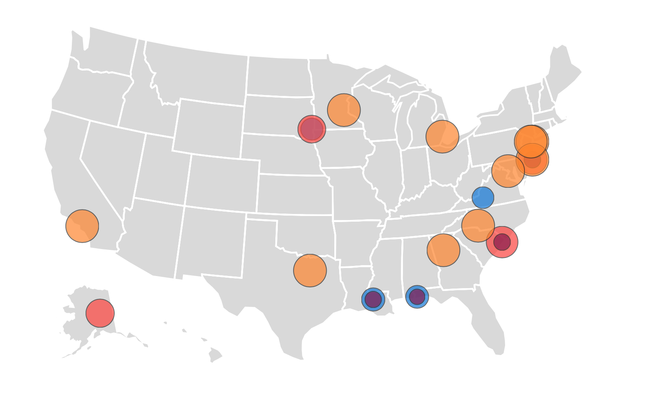
Top Popular Travel Cities during Holidays
Top popular cities in all holidays:
Atlanta; Dallas; New York; Houston; Detroit; Minneapolis; Washington, DC; Charlotte; Los Angeles.
Hot cities in Spring break:
Myrtle Beach, SC; Baton Rouge, LA; Pensacola, FL; Atlantic City, NJ
Hot cities in Summer break:
Sioux Falls, SD; Myrtle Beach, SC; Fairbanks, AK; Atlantic City, NJ
Hot cities in Winter break:
Sioux Falls, SD; Roanoke, VA; Baton Rouge, LA; Pensacola, FL

Slide 25

Trends of Population and Flights

Slide 26
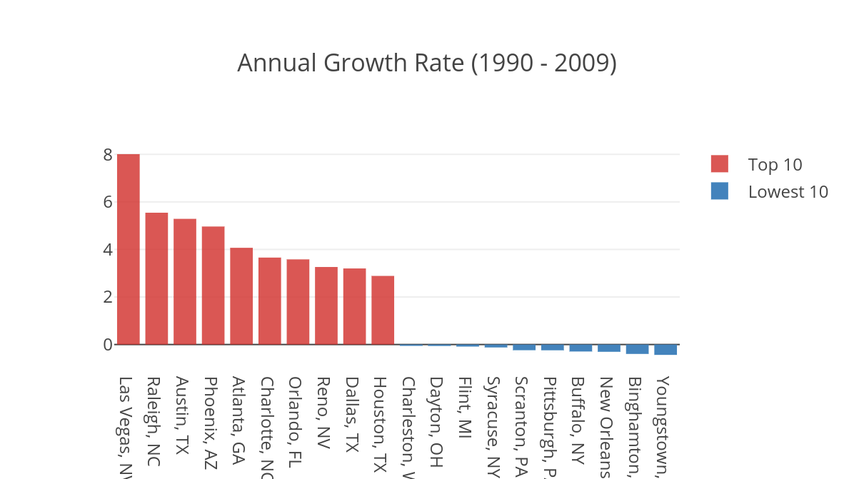
Trends of Population and Flights

Slide 27
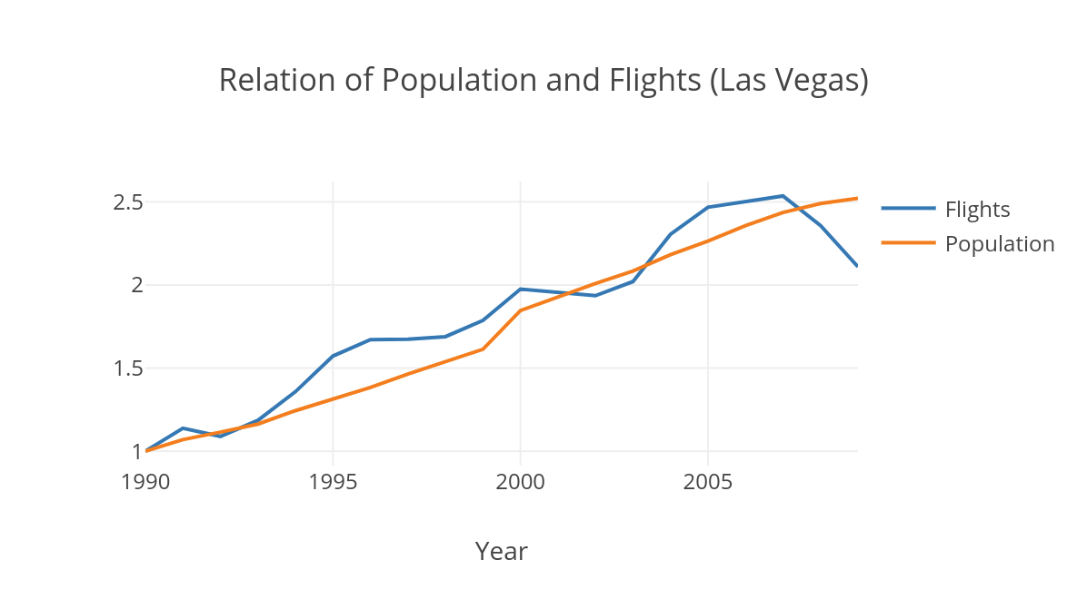
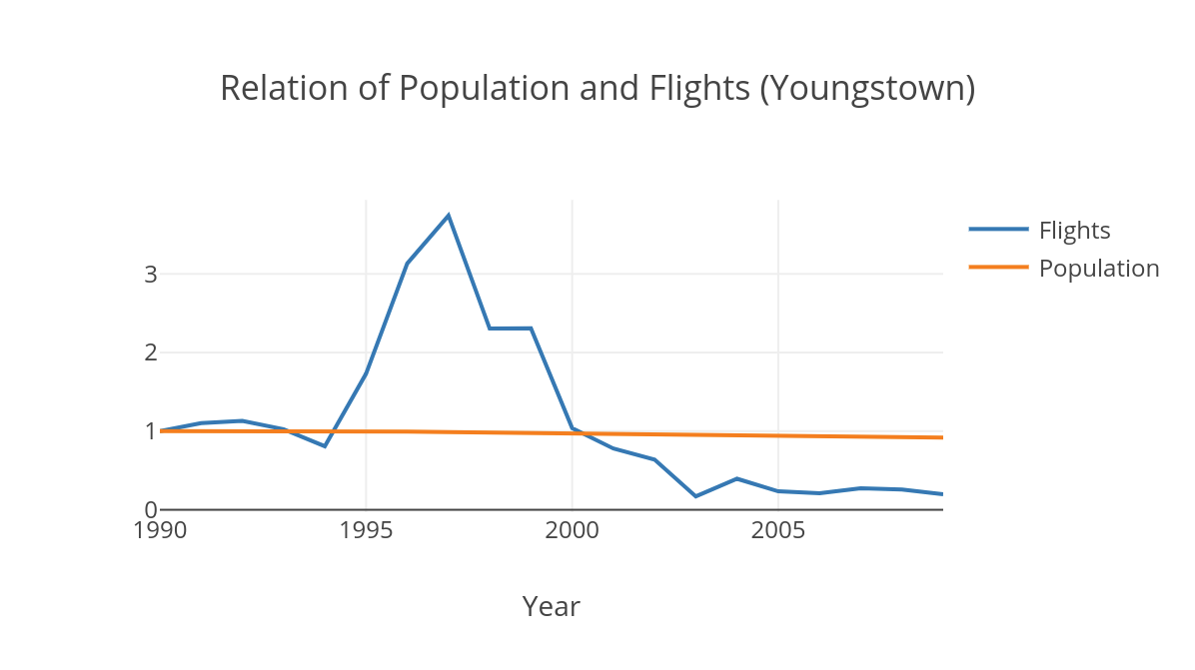
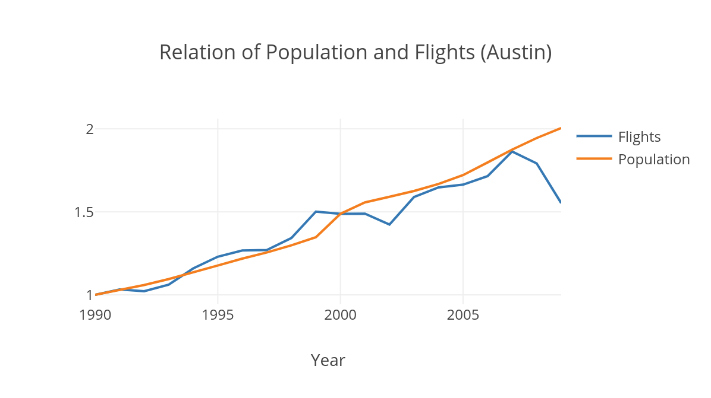
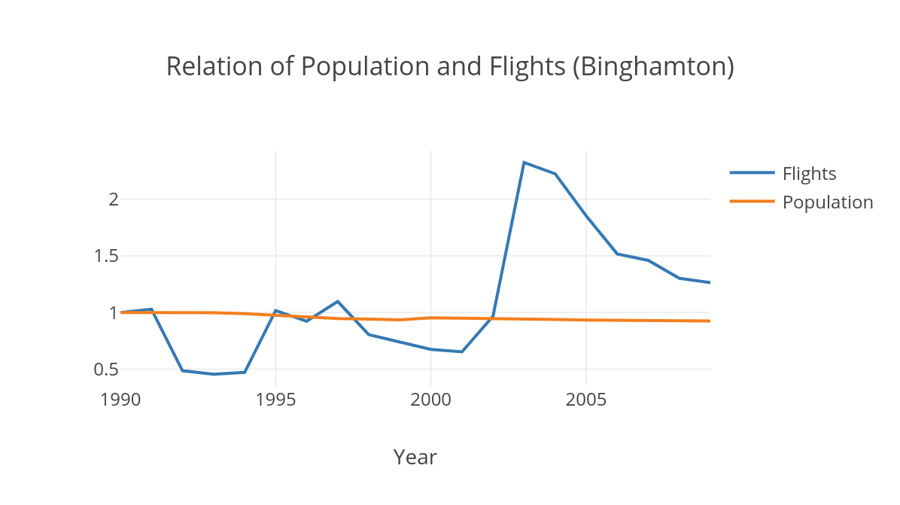
Trends of Population and Flights

Slide 28
Flight Occupancy Prediction

Slide 29

Motivations
By optimizing airplane sizes based to predicted occupancy:
Reduce overbooking
Lower CO2 emission
Increased profit
https://www.spectatornews.com/opinion/2017/04/18/cost-benefit-of-overbooking-flights/

Slide 30
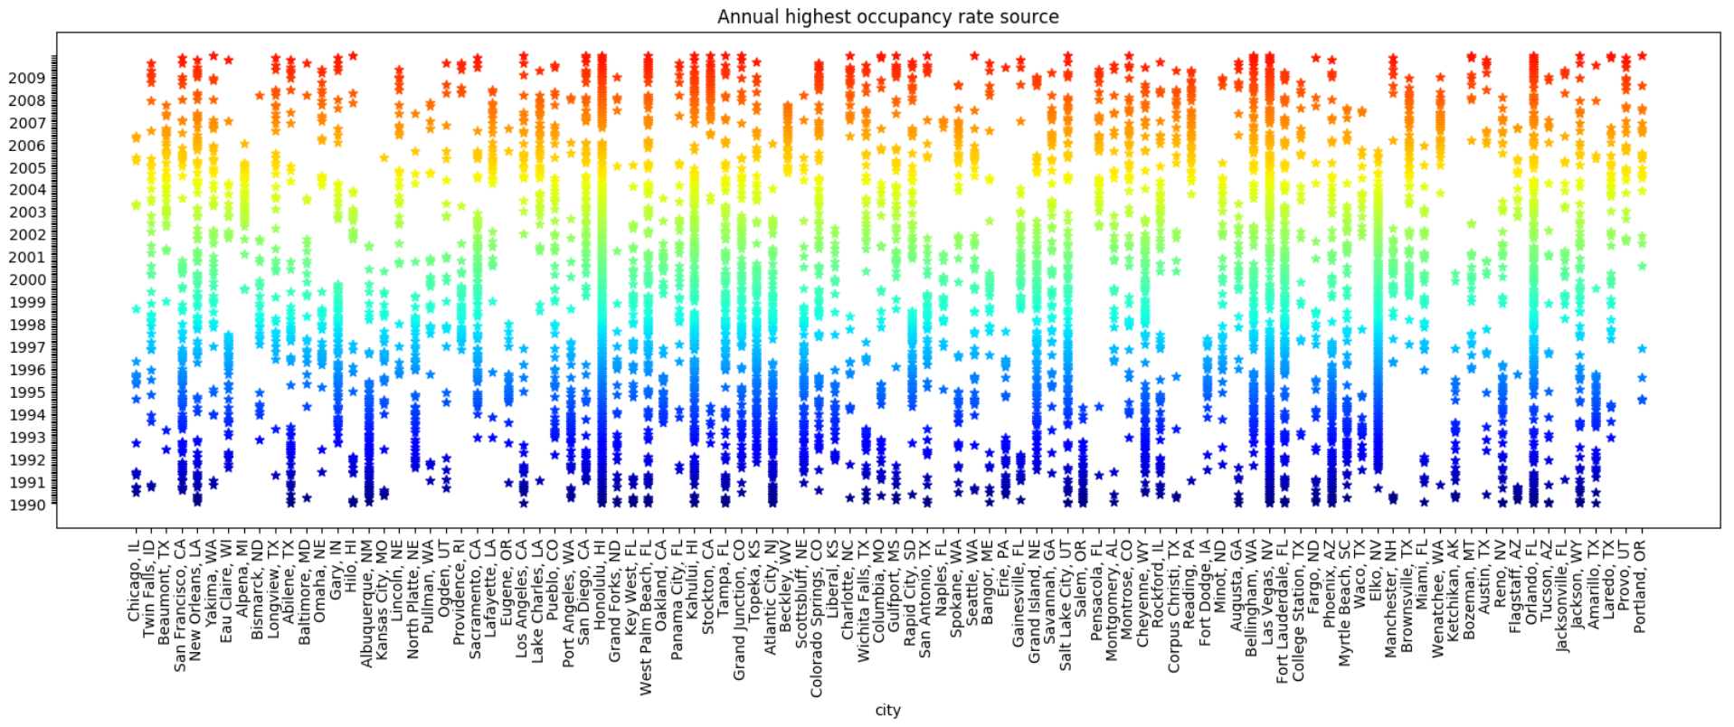
Correlations: City (Origin) and Occupancy

Slide 31
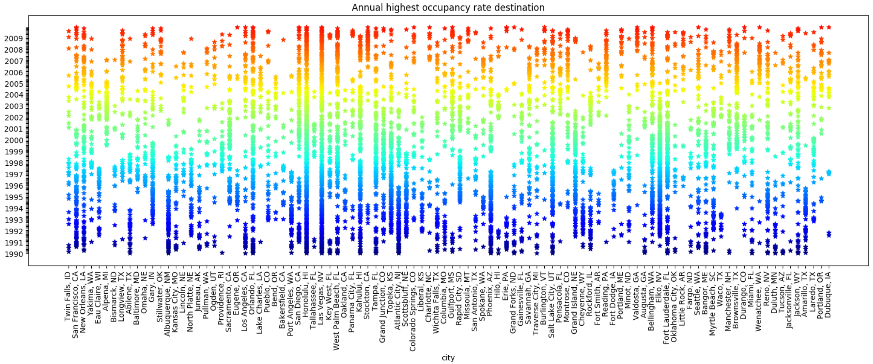
Correlations: City (Destination) and Occupancy

Slide 32
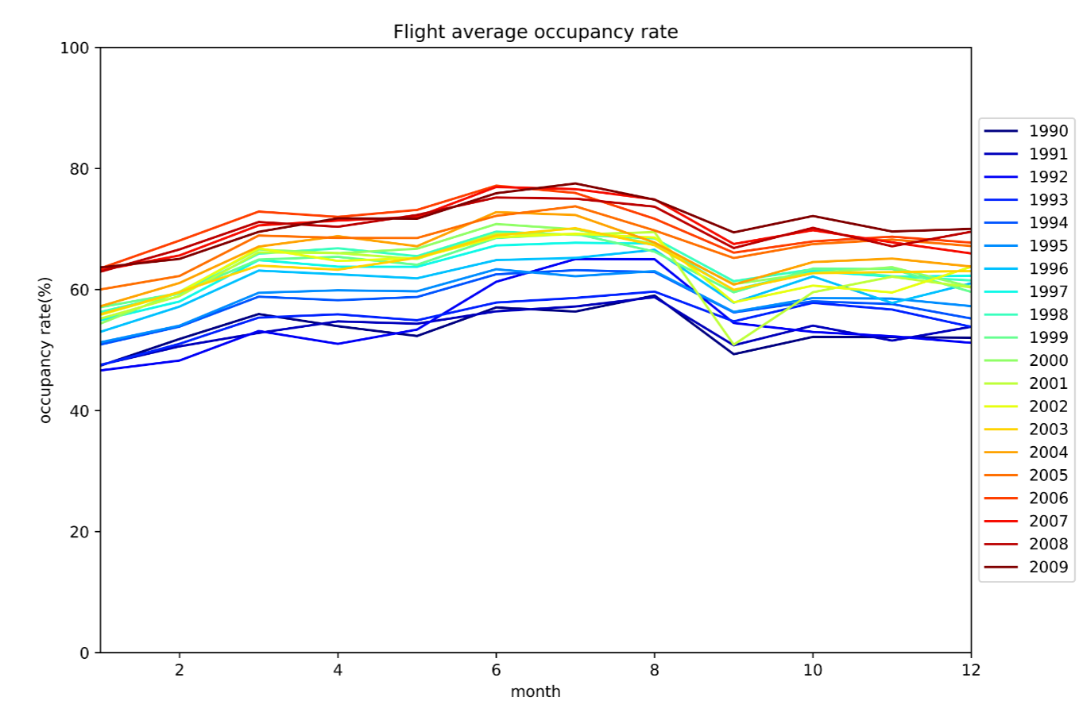
Correlations: Month/Year and Occupancy
911

Slide 33
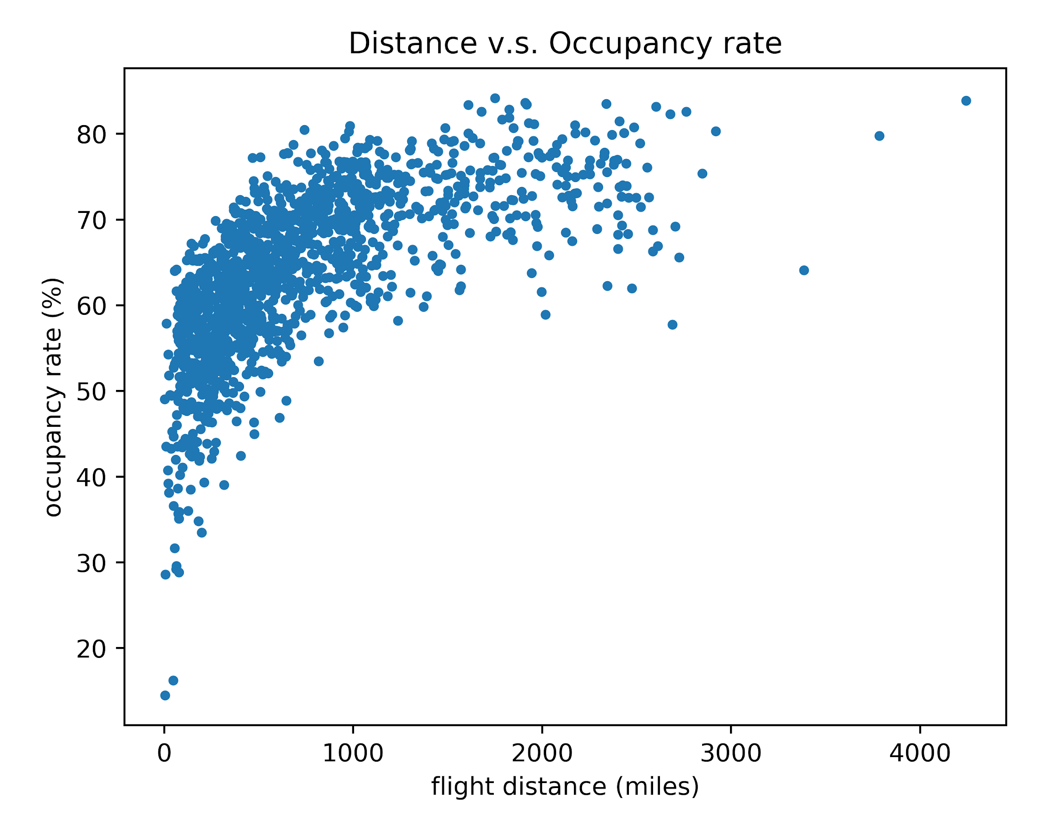
Correlations: Distance and Occupancy

Slide 34
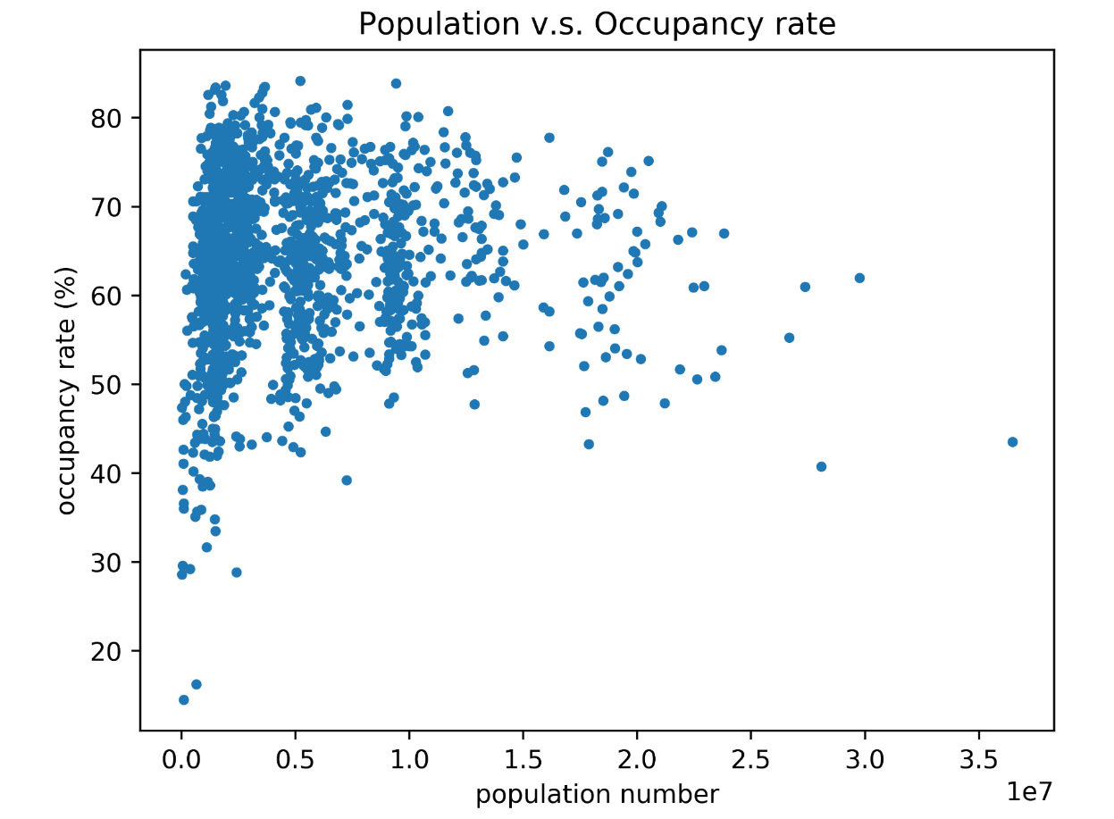
Correlations: Population and Occupancy

Slide 35
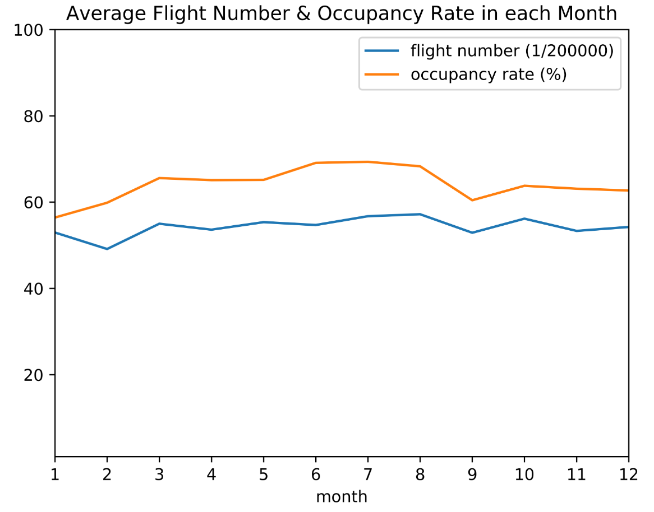
Correlations: Flights and Month

Slide 36
Prediction Model: Polynomial Regression
Input features:
-Origin/Destination -Origin/Destination population
-Flights -Distance
-Fly Date
Predicting output:
Occupancy = Passengers/Seats

Slide 37
Polynomial Regression: Step-1
Feature encoding: Transform origin/destination city into binary feature
For example:
Cities within database: Chicago, Los Angeles, San Diego, New York
Flight: San Diego to New York
Chicago | Los Angeles | San Diego | New York
0 | 0 | 1 | 1

Slide 38
Polynomial Regression: Step-2
Selecting features to be extended into polynomial:
Linear Feature: Distance Origin/Destination Destination/Origin population
Degree-12 Polynomial Feature: Month Flights
Features | Origin/Destination | Origin/Destination pop. | Distance | Month & Flights | Total Feature Size
Pre-extension size | 358 | 2 | 1 | 2 | 363
Post-extension size | 358 | 2 | 1 | 92 | 453

Slide 39
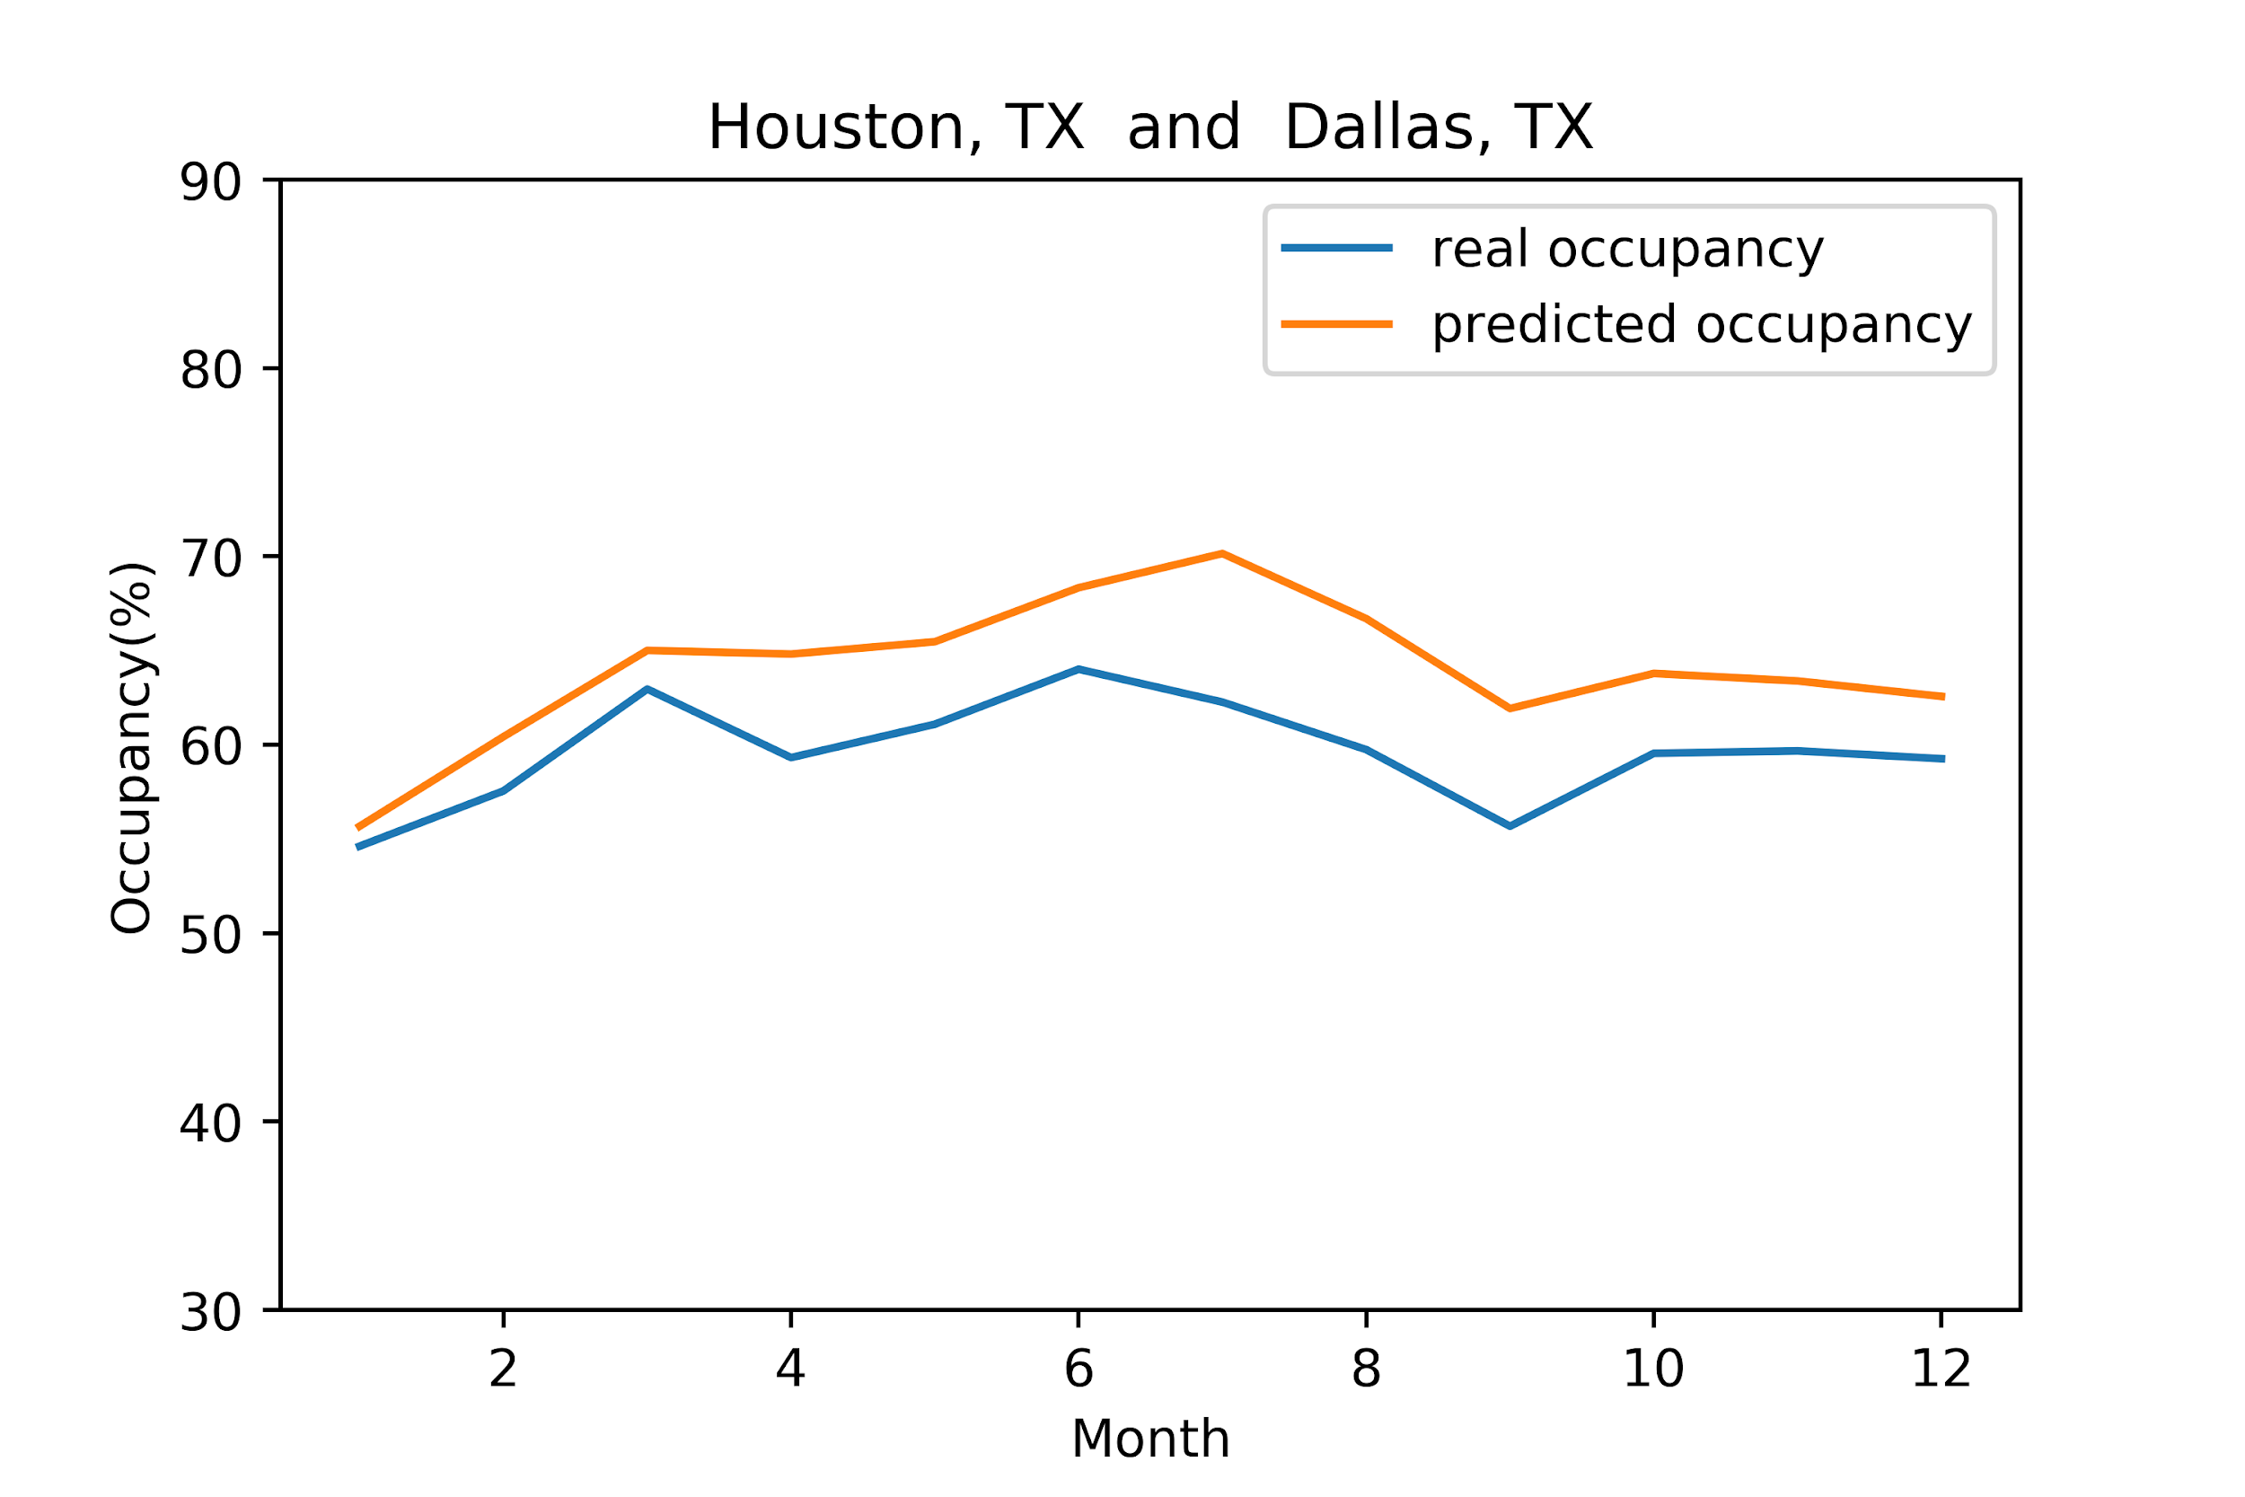
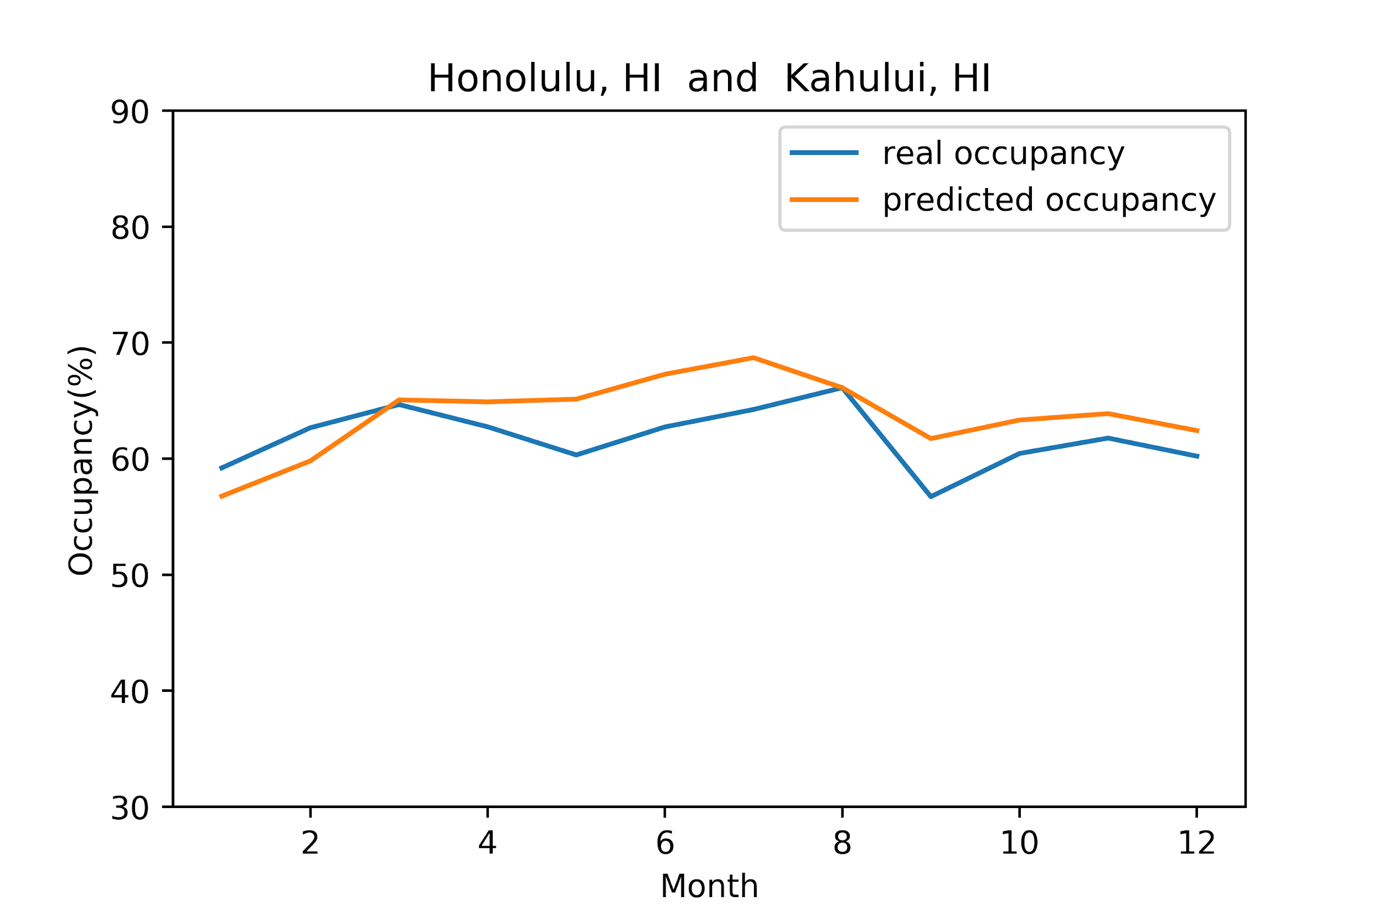
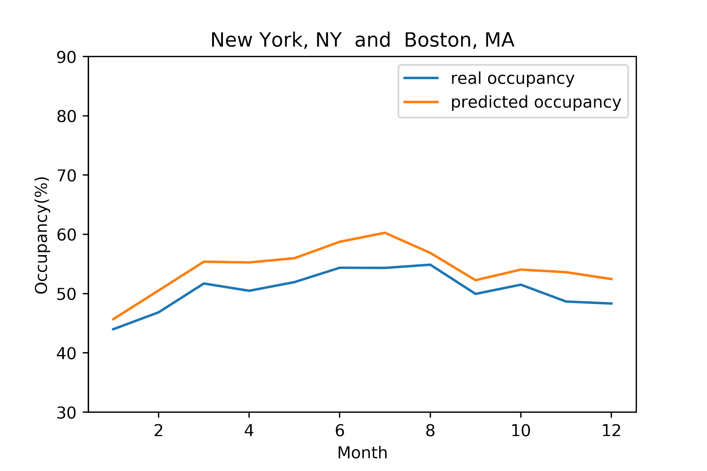
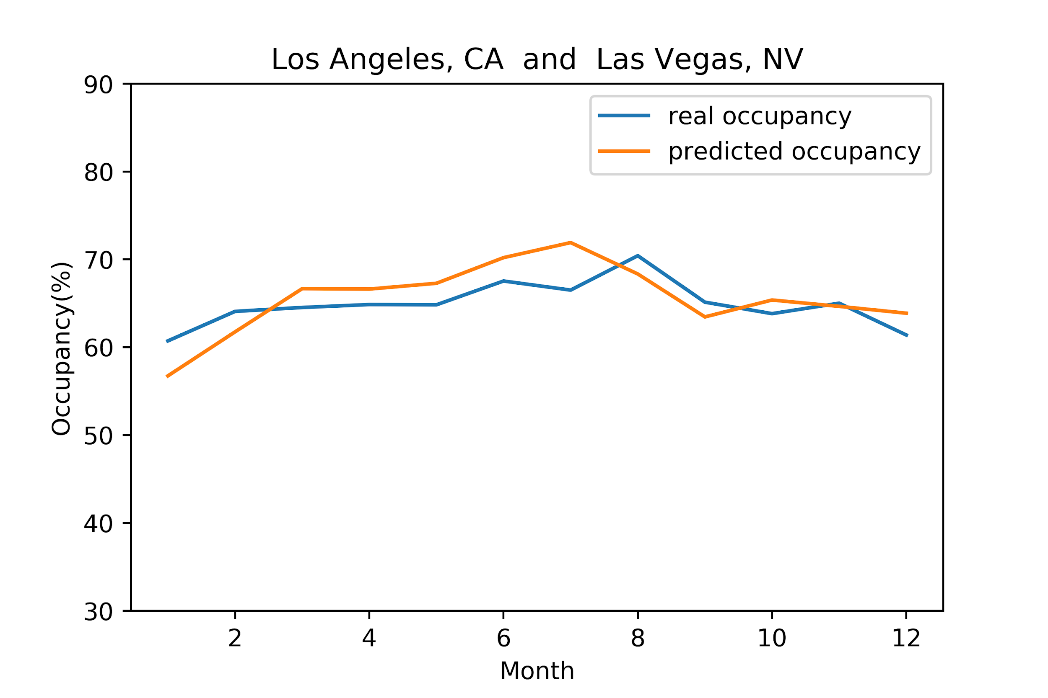
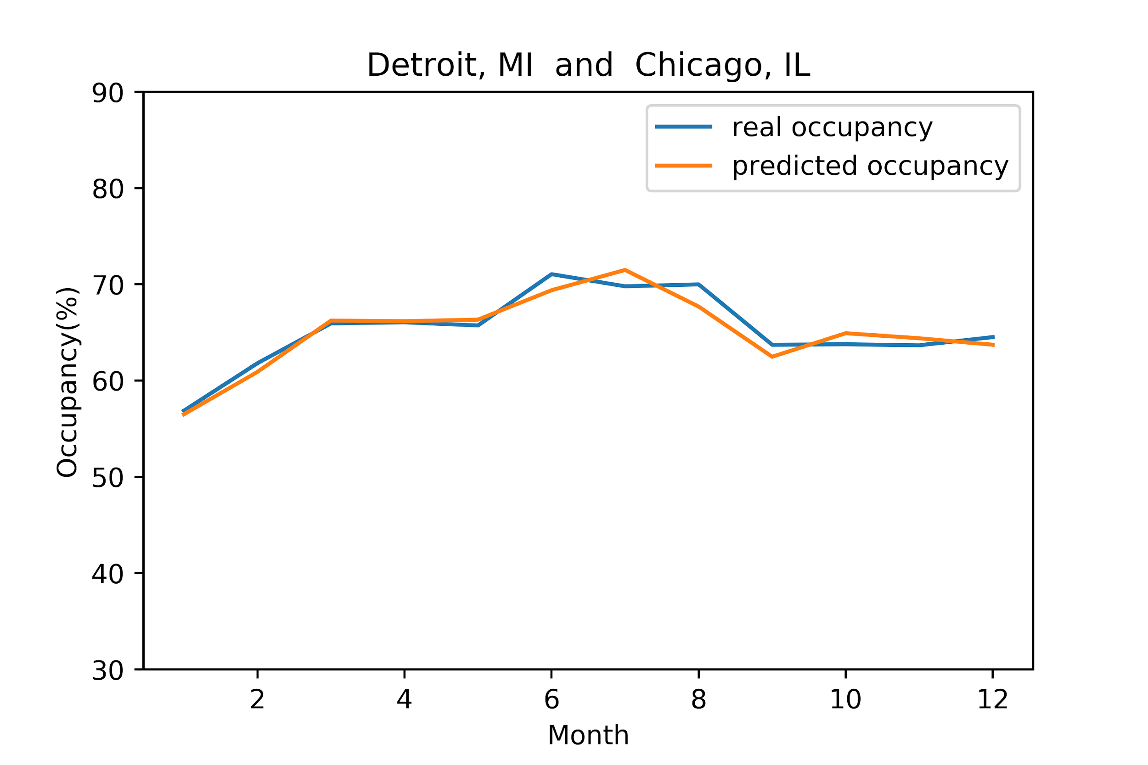
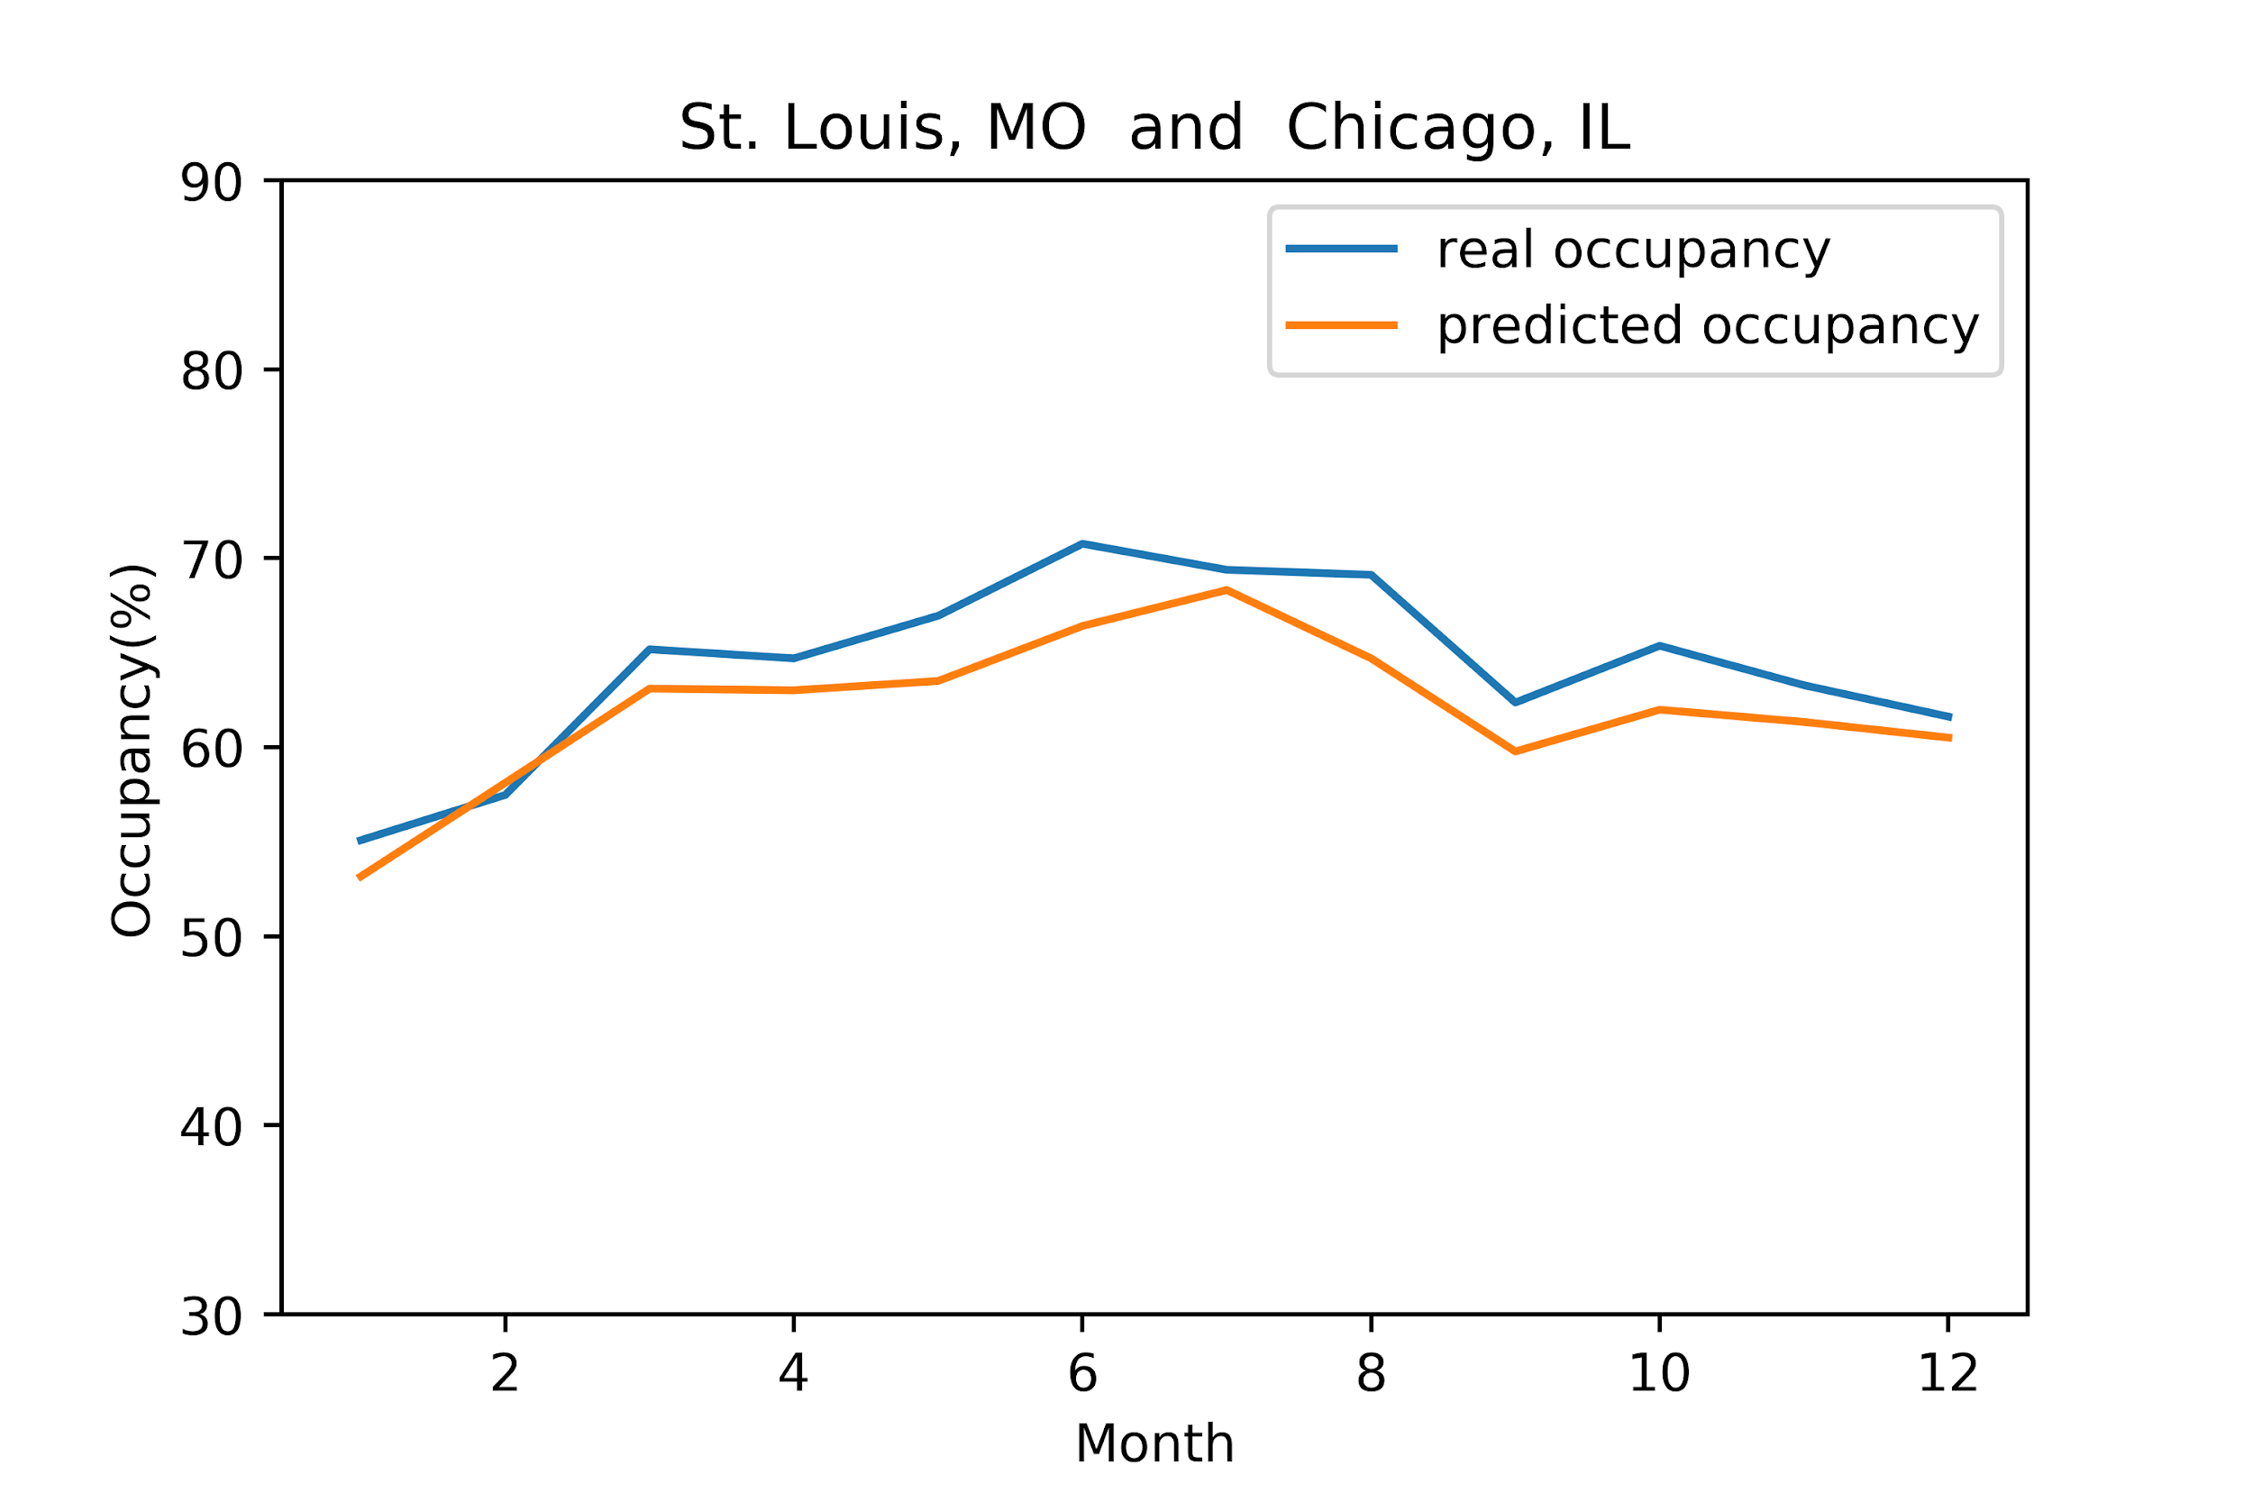
Results: Flight Occupancy based on city/month

Slide 40
Citations:
[1] Locsin, Aurelio. "Is Air Travel Safer Than Car Travel?" Travel Tips - USA Today,
http://traveltips.usatoday.com/air-travel-safer-car-travel-1581.html. Accessed 10 March 2018.
[2]Debarati Guha-Sapir, Philippe Hoyois, Pasacline Wallemacq, and Regina Below. “Annual Disaster Statistical
Review 2016: The Numbers and Trends.” ReliefWeb, 31 Oct. 2017, reliefweb.int/report/world/annual-disaster-statistical-review-2016-numbers-and-trends.

